Slide 1
Photo Album
Saibaba Installation
IT PARK-HUBLI

Slide 2
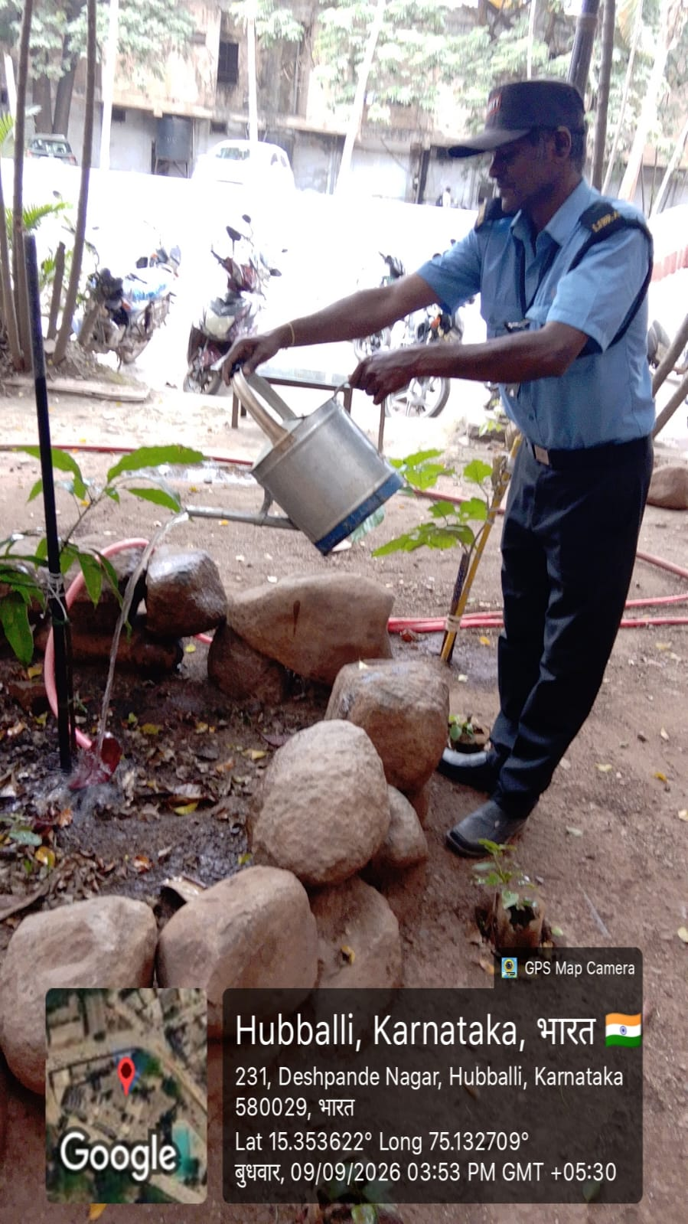
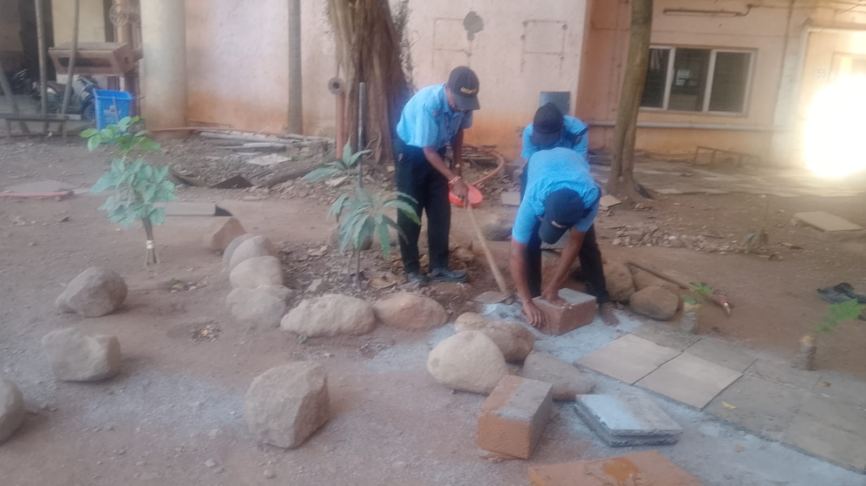
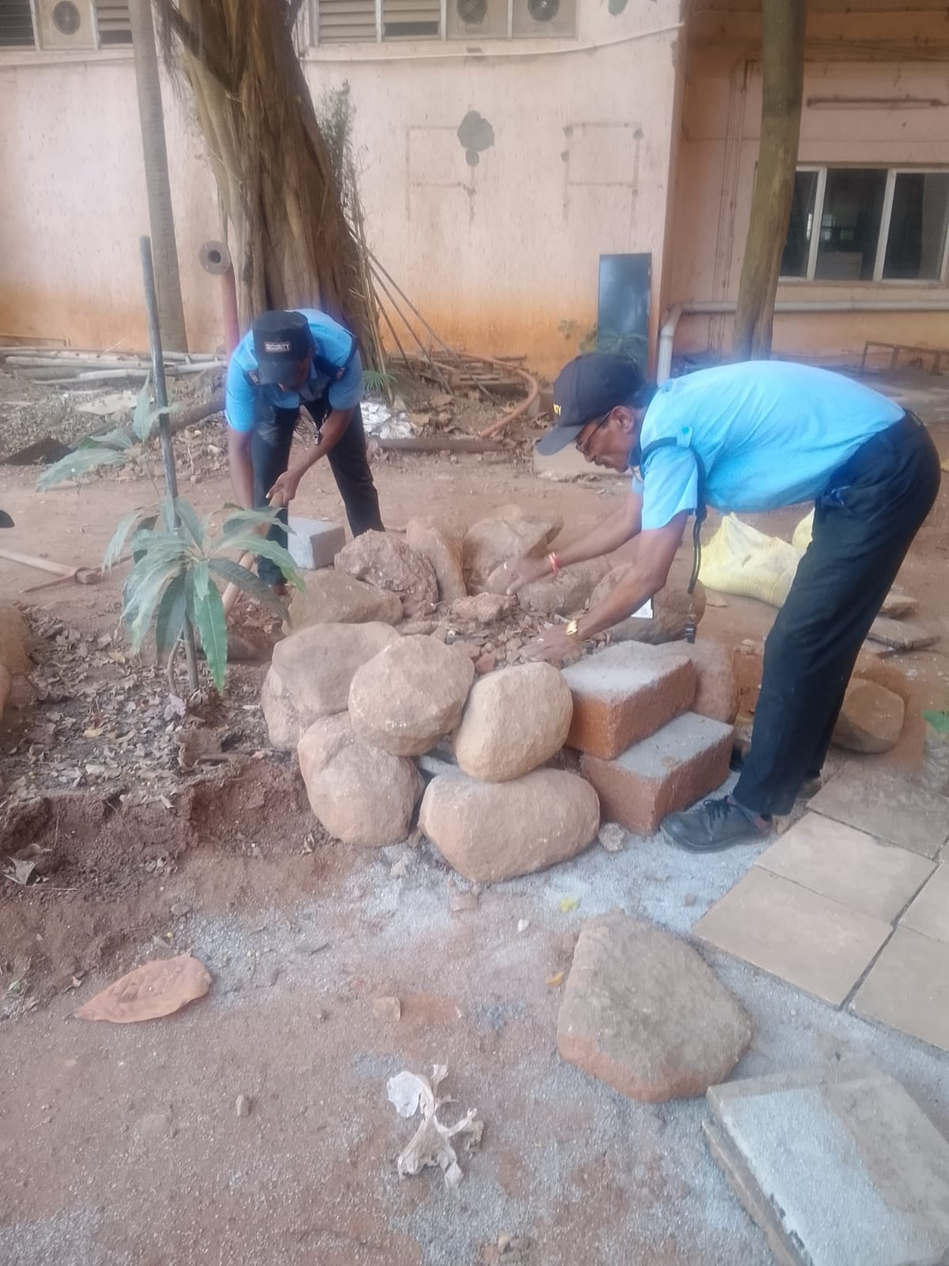
Before Installation of Sai Baba Idol - Site Preparation and Cleaning by Security Staff

Slide 3
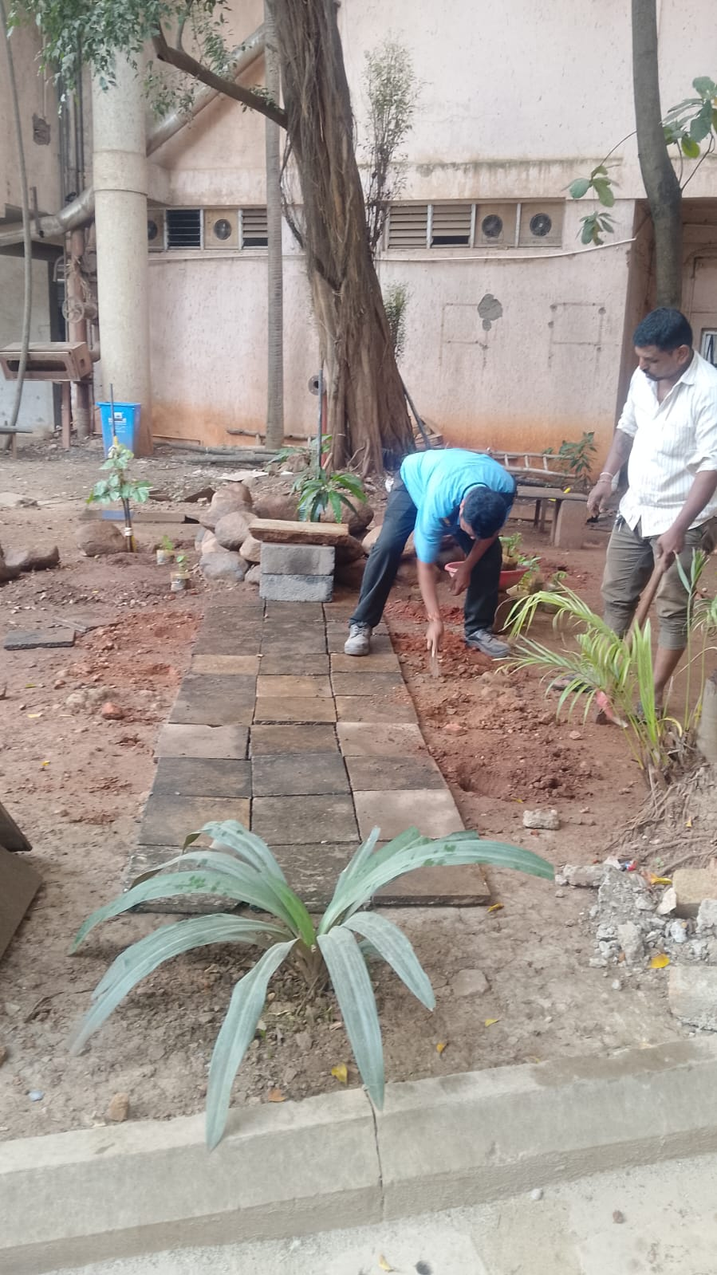
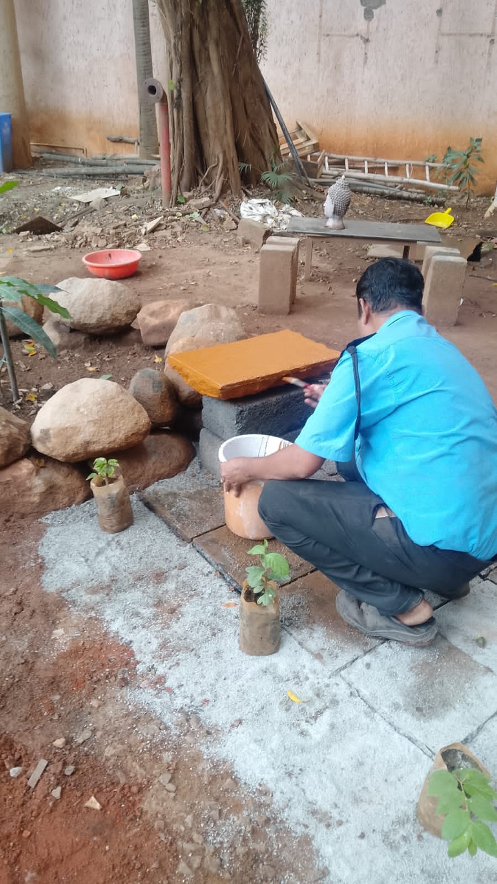
Before Installation of Sai Baba Idol - Site Preparation and Cleaning by Security Staff

Slide 4
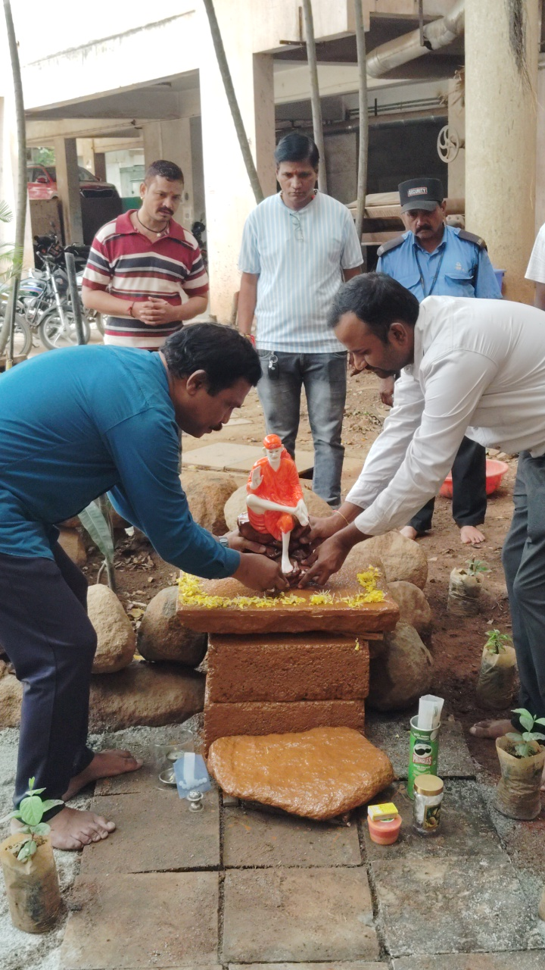
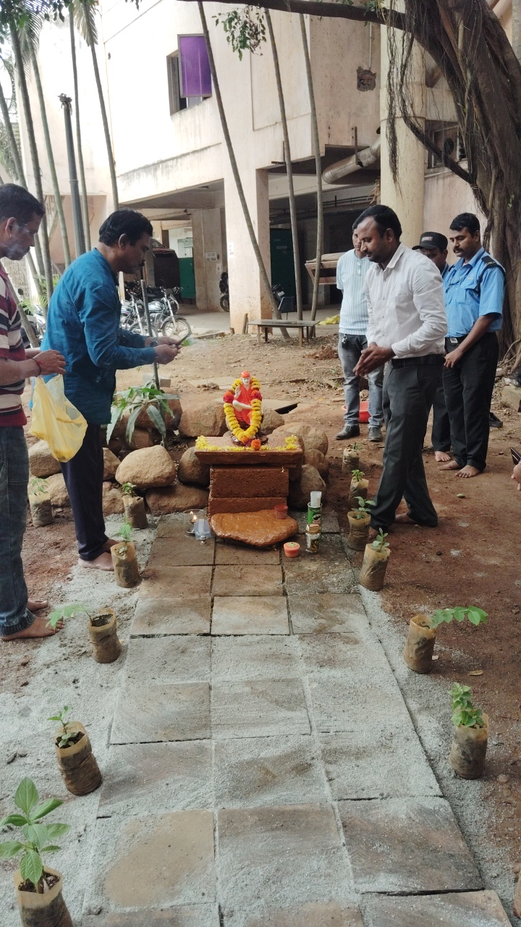
Installation of Sai Baba Idol by Respected Manager and Assistant Manager

Slide 5
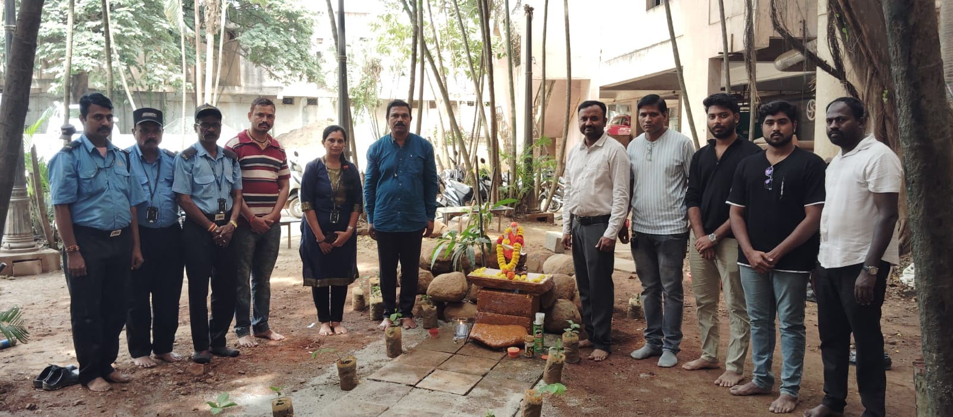
Group Photo with Respected Manager and Assistant Manager After Idol Installation

Slide 6
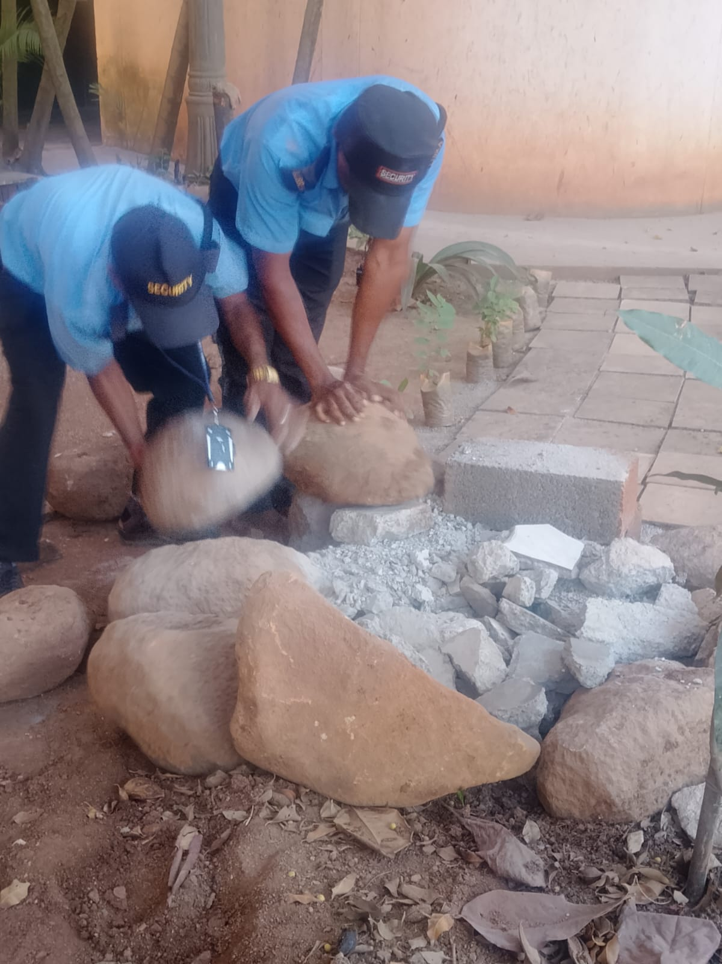
Security Team Re-installing Baba Idol at a Higher Position

Slide 7
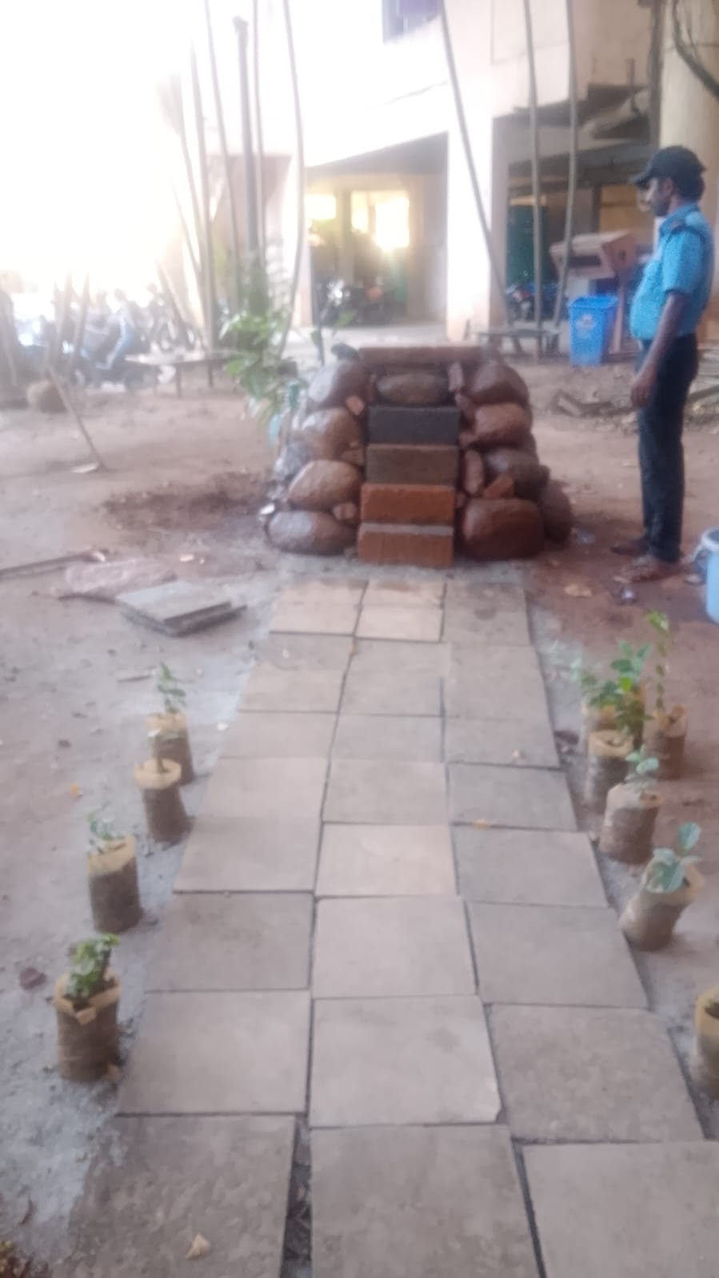
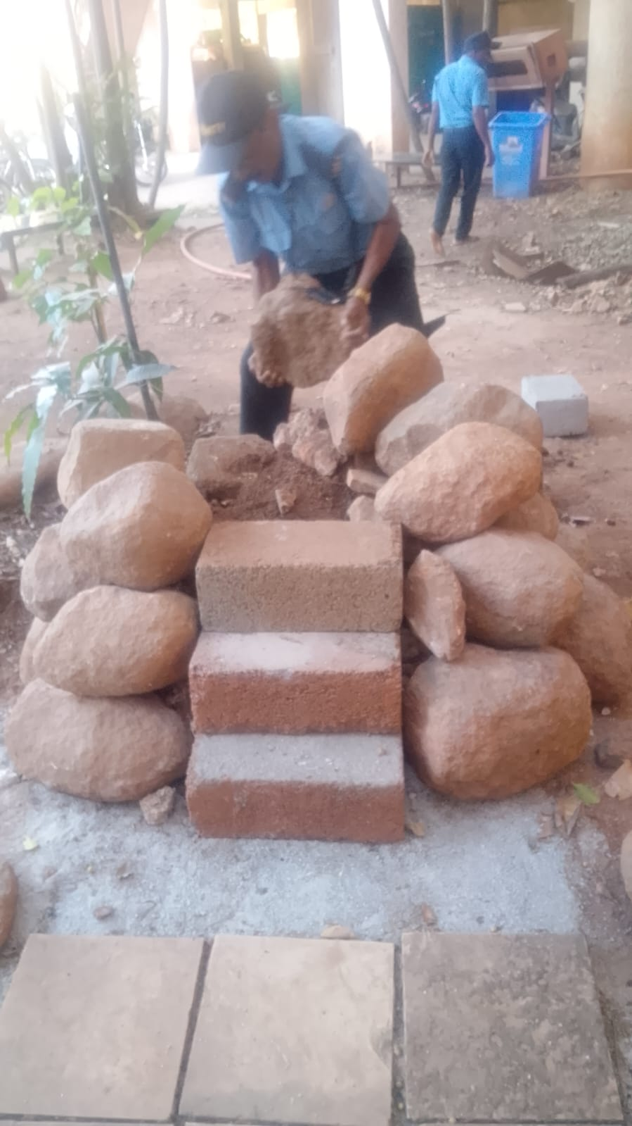

Slide 8
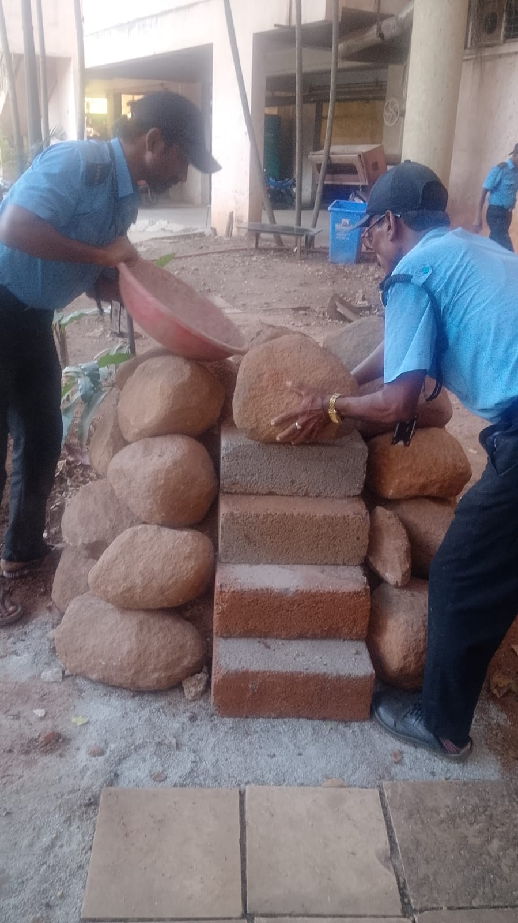

Slide 9
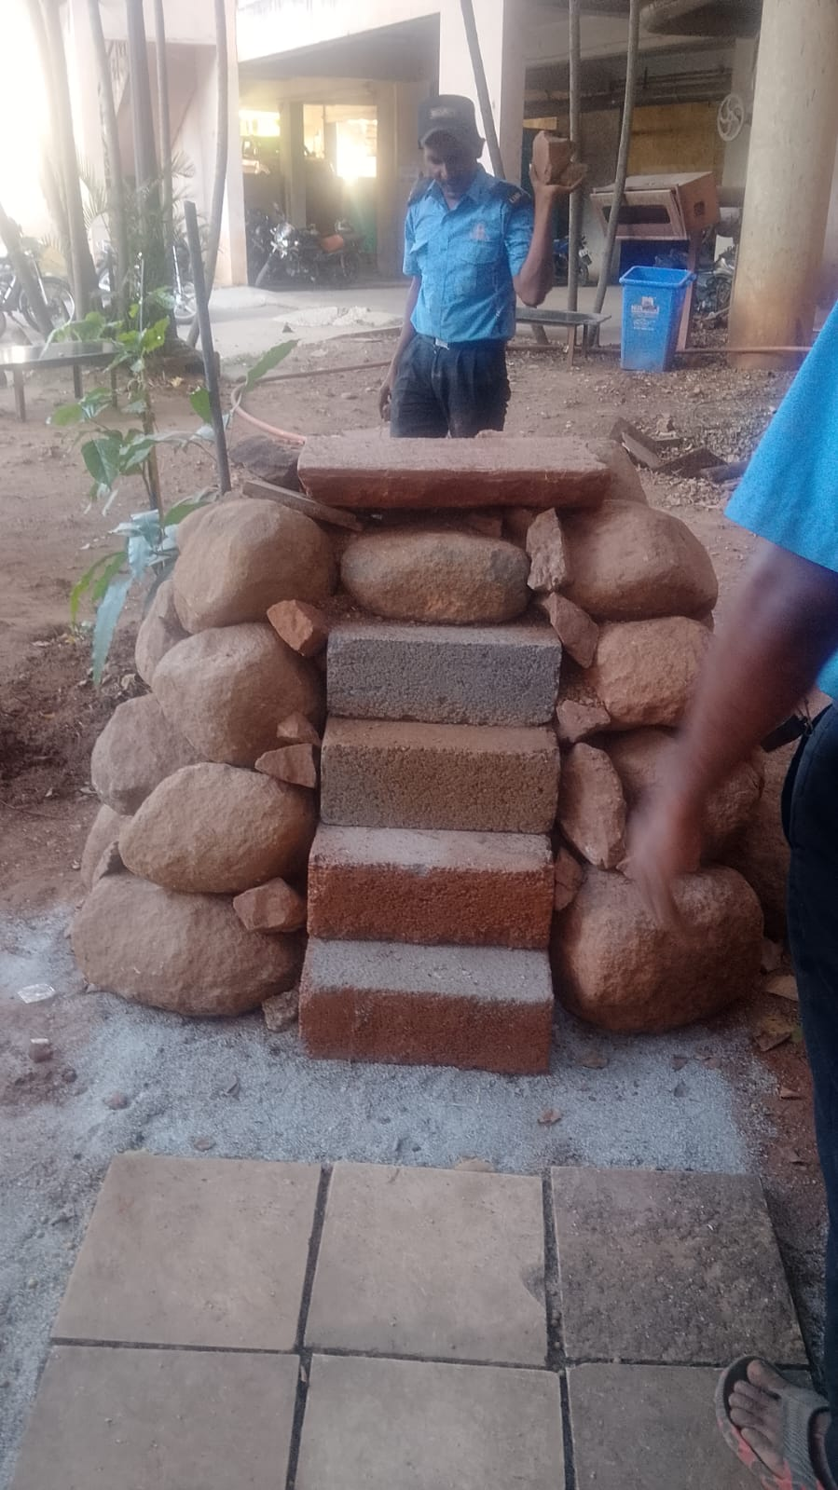

Slide 11
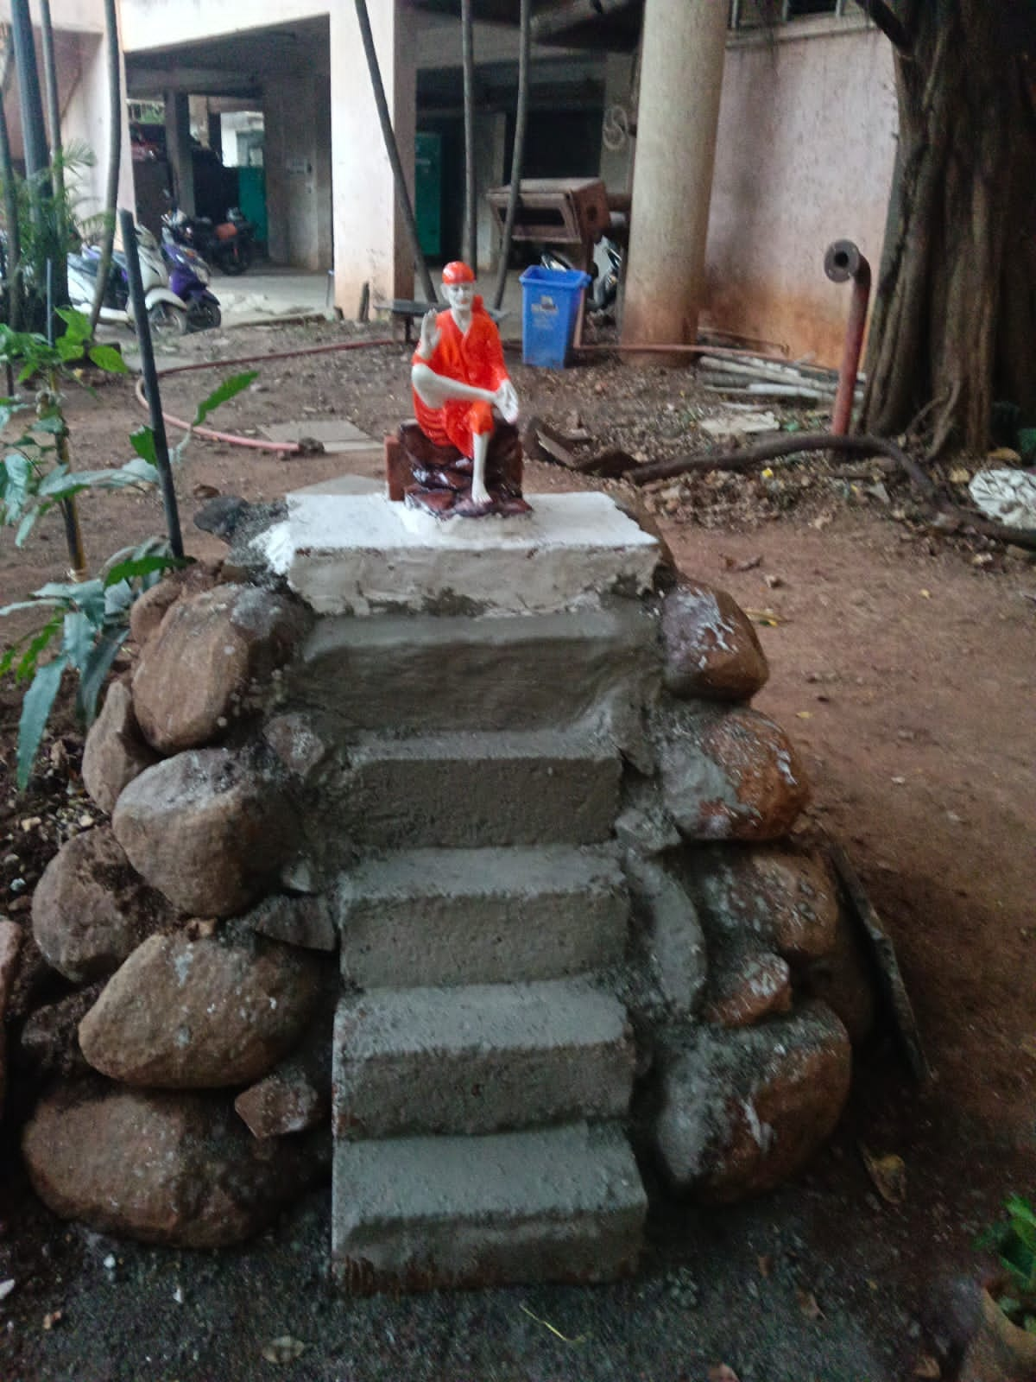
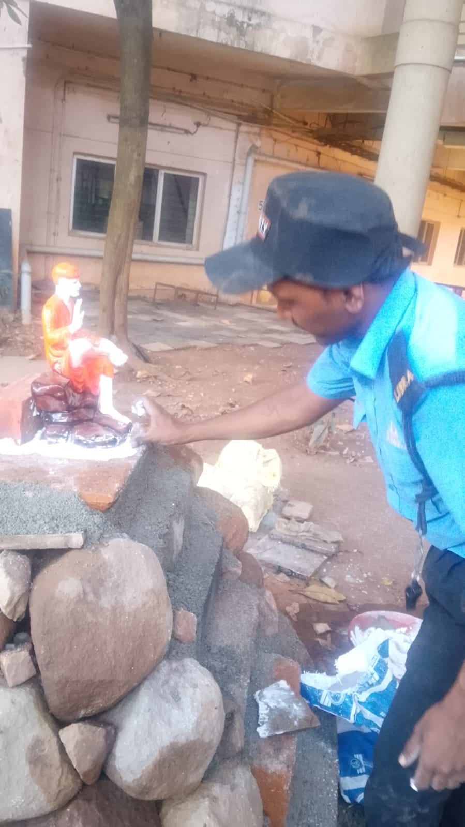
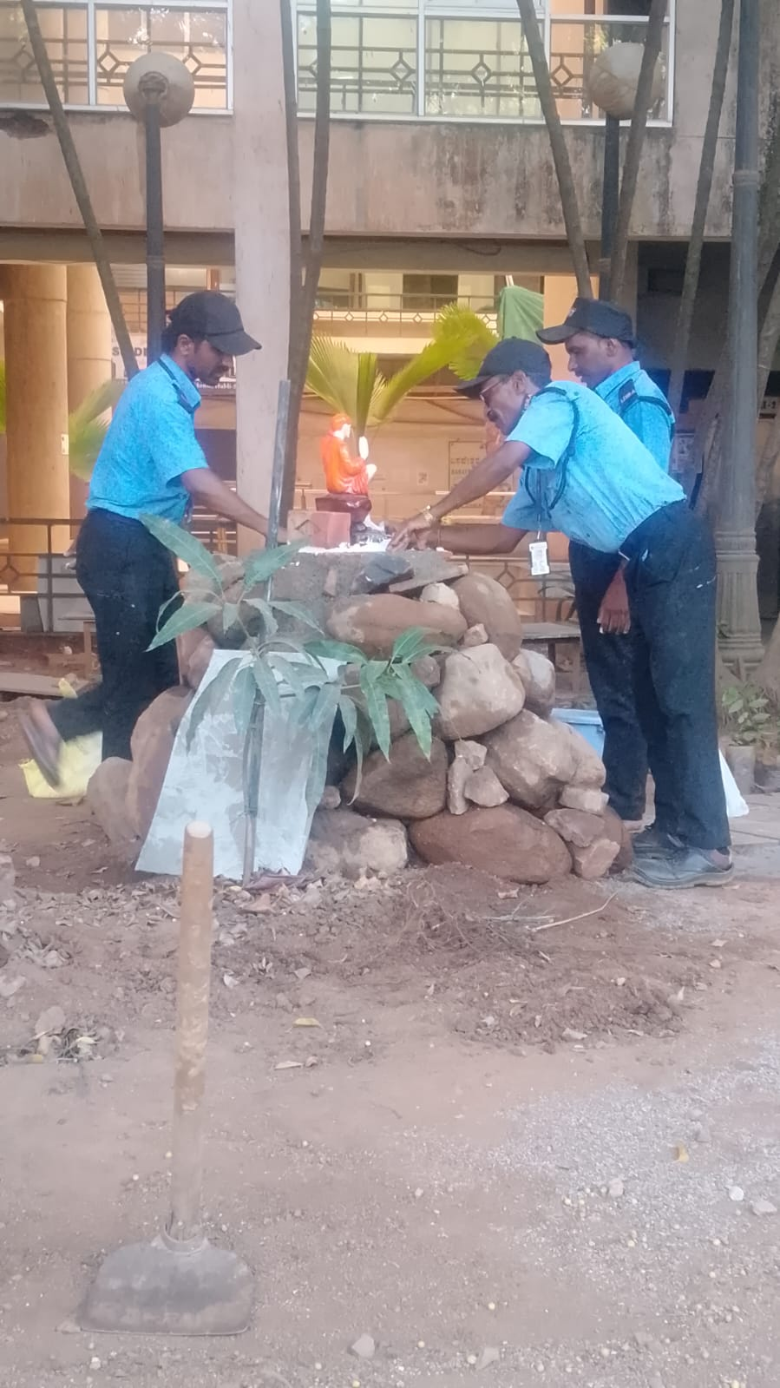
Baba Idol being Repositioned at Height by Security Staff

Slide 12
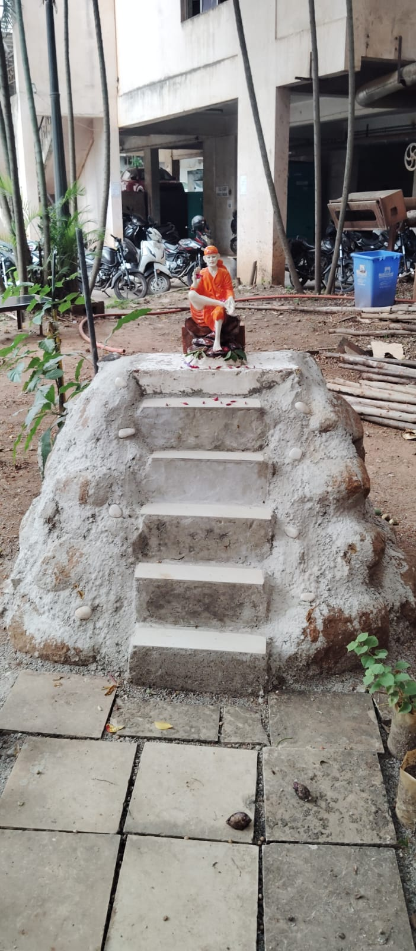
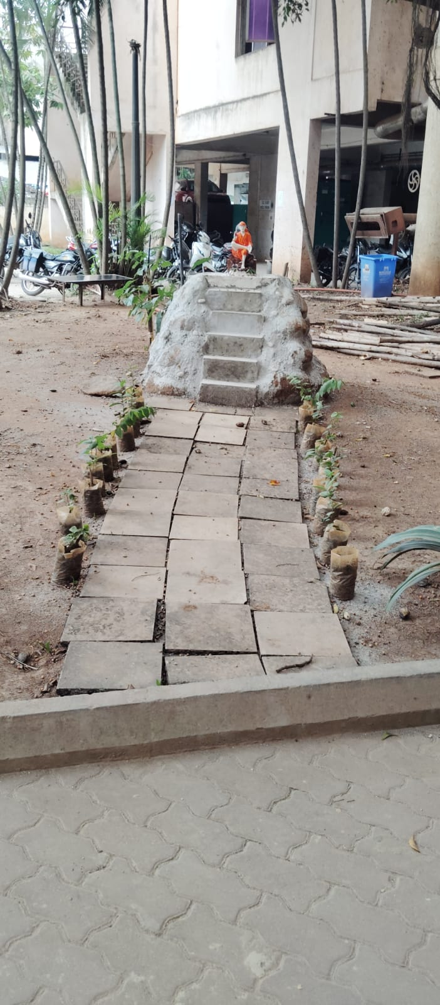

Slide 13
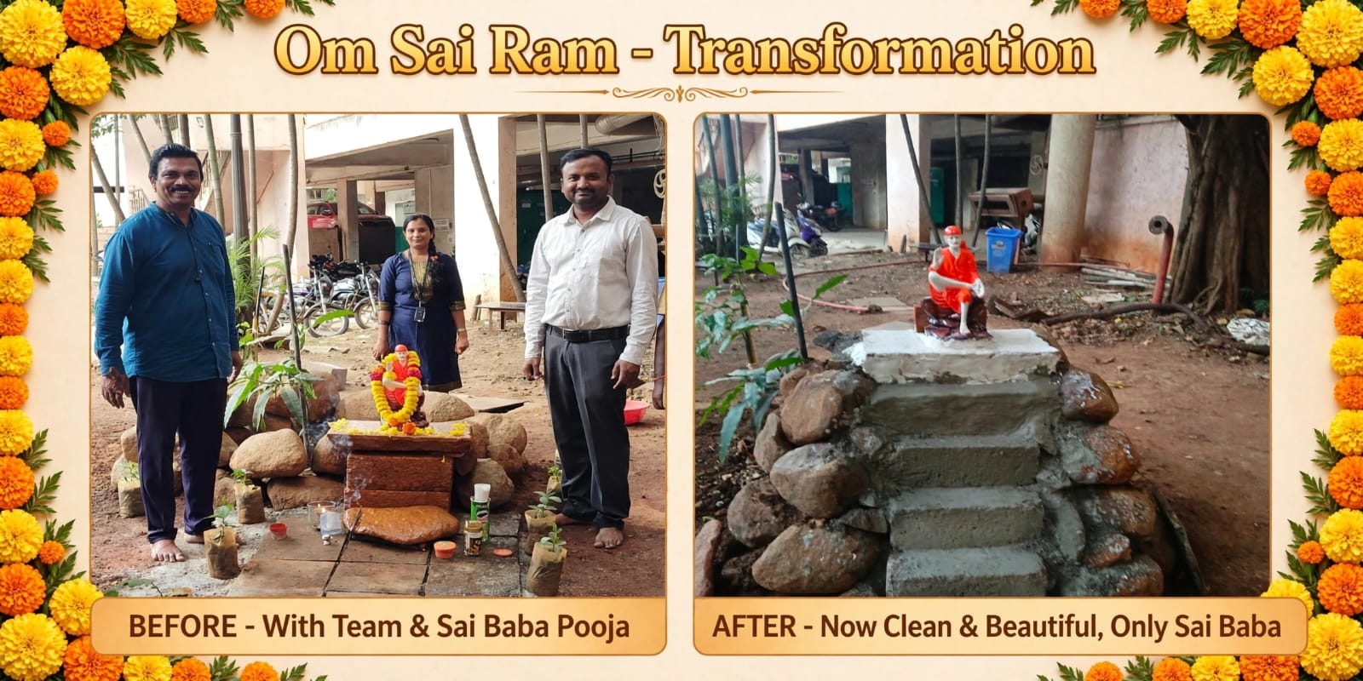
Final Placement After Modification - Sai Baba Seated,
Transformation With Team
BEFORE and AFTER - Results

Slide 14
THANK YOU FOR WATCHING

